Slide 1
SNAKE GAME
TEAM MEMBERS - Yashas S Reddy , 1BM18IS125
Pavithra S , 1BM19IS134
NIKHIL V WADHWA,1BM19IS102
SUBMITTED TO - Sindhu K

Slide 2
TABLE OF CONTENTS
ABSTRACT
INTRODUCTION
TOOLS USED
WORKING OUTPUT OF CODE
IMPLEMENTATION OF CODE

Slide 3
ABSTRACT
Can be seen from outer space
Located in Queensland, AU
2
3
1
World’s largest coral reef system
The snake game in java uses the loadImages() method we get the images for the game. The ImageIcon class is used for displaying PNG images. In the initGame() method we create the snake, randomly locate an apple on the board, and start the timer. If the apple collides with the head, we increase the number of joints of the snake.
Here , only one person can play . Hence it is a single player game .
Snake is a classic game that requires players to assess their surroundings and find the quickest or safest route to a point. This is an excellent opportunity to learn about spatial awareness and plan ahead to your next move.

Slide 4
INTRODUCTION
This is a part of the Java 2D games , we create a Java Snake game clone.
Snake is an older classic video game. It was first created in late 70s. Later it was brought to PCs. In this game the player controls a snake. The objective is to eat as many apples as possible. Each time the snake eats an apple its body grows. The snake must avoid the walls and its own body. This game is sometimes called Nibbles.
The game ends when the snake collides with the wall or its own body .

Slide 5
TOOLS USED
ActionListener
Swing
AWT
Graphics 2D
Overriding
KeyListener
ActionEvent
IOException
PrintWriter
FileReader
FileWriter
Scanner
PrintWriter

Slide 6
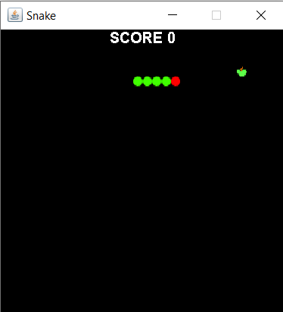
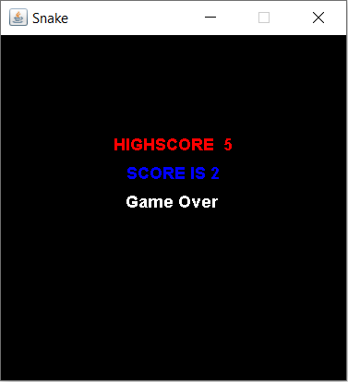
WORKING OUTPUT OF CODE

Slide 7
IMPLEMENTATION OF CODE
1. private final int DOT_SIZE = 10; // 300 * 300 = 90000 / 100 = 900
private final int ALL_DOTS = 900;
private final int RANDOM_POSITION = 29;
The DOT_SIZE is the size of the apple and the dot of the snake. The ALL_DOTS constant defines the maximum number of possible dots on the board ( 300 * 300 = 90000 / 100 = 900). The RANDOM_POSITION constant is used to calculate a random position for an apple. The DELAY constant determines the speed of the game.
2. private final int x[] = new int[ALL_DOTS];
private final int y[] = new int[ALL_DOTS];
These two arrays store the x and y coordinates of all joints of a snake.

Slide 8
IMPLEMENTATION OF CODE
3. public void checkApple(){
if((x[0] == apple_x) && (y[0] == apple_y)){
dots++;
locateApple(); } }
If the apple collides with the head, we increase the number of joints of the snake. We call the locateApple() method which randomly positions a new apple object.
4. if (y[0] >= 900) {
inGame = false;
}
If the snake hits one of its joints with its head the game is over.

Slide 9
IMPLEMENTATION OF CODE
5. for (int z = dots; z > 0; z--) {
x[z] = x[(z - 1)];
y[z] = y[(z - 1)]; }
In the move() method we have the key algorithm of the game. To understand it, look at how the snake is moving. We control the head of the snake. We can change its direction with the cursor keys. The rest of the joints move one position up the chain. The second joint moves where the first was, the third joint where the second was etc.
6. if (leftDirection) {
x[0] -= DOT_SIZE;
}
This line moves the head to the left.

Slide 10
thank you

